Slide 1
E-Commerce User Behavior & Conversion Analysis
Analyzing customer journeys, conversion behavior, and A/B test outcomes to inform optimization decisions

Slide 2

Business Context & Objective
E-commerce performance depends on understanding how users navigate, engage, and convert
Traffic sources, device usage, and page behavior influence funnel outcomes
Experiments are used to test changes, but results must be evaluated holistically
Objective Statement: This analysis examines user behavior, conversion performance, and experiment outcomes to identify optimization opportunities across the customer journey.

Slide 3
Data Overview
Include:
~100K customers
~528K sessions
~1M events
Key data elements:
User events (view, click, add to cart, purchase)
Traffic source and device type
Page category interactions
Experiment group assignment

Slide 4
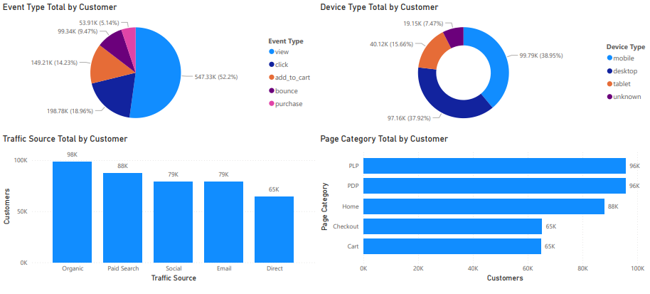
Customer & Traffic Composition
Views dominate user activity, with a steep drop-off toward purchase.
Organic and paid search drive the highest customer volume
Product and listing pages receive the most engagement
Mobile and desktop usage are nearly balanced

Slide 5
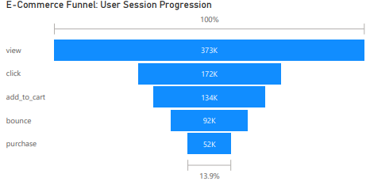
Funnel Performance
Significant drop-off occurs between view and click stages
Overall funnel conversion is ~14%
Cart and checkout stages represent major friction points

Slide 6
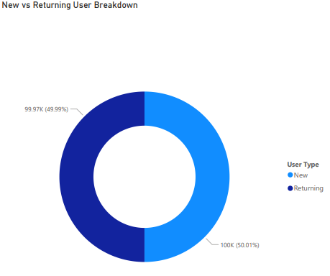
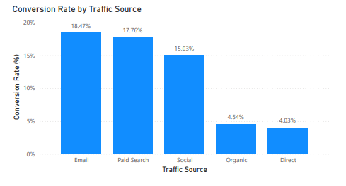
Conversion Drivers
Email and paid search show the highest conversion rates
Organic and direct traffic convert at much lower rates
New and returning users are nearly evenly split

Slide 7
A/B Testing and Experiment Overview
An A/B test was conducted to evaluate changes in user engagement and conversion behavior.

Slide 8
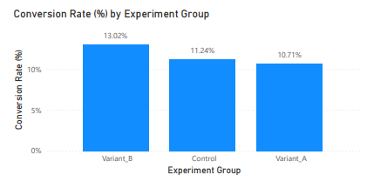
Conversion Performance by Variant
Variant B shows the highest conversion rate
Control outperforms Variant A
Differences suggest measurable impact from experiment changes

Slide 9
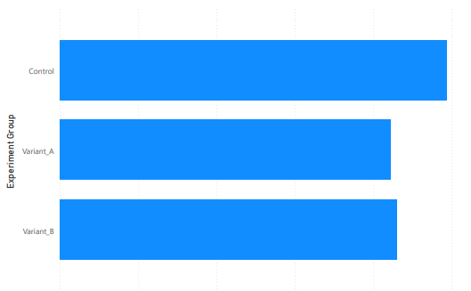
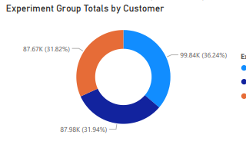
Engagement vs Conversion
Higher engagement does not always translate directly to higher conversion
Variant B balances engagement and conversion most effectively
Traffic distribution across variants is relatively even

Slide 10
Key Insights Summary
User drop-off is driven primarily by mid-funnel friction
Traffic source quality matters more than volume
Mobile and desktop users behave similarly at a high level
Variant B delivers the strongest balance of engagement and conversion

Slide 11
Recommendations and Next Steps
Prioritize optimization of click-to-cart and cart-to-checkout stages
Shift acquisition focus toward high-converting traffic sources
Roll out Variant B for further validation
Run follow-up experiments targeting funnel friction points

